Slide 1
Research Cash Advance: Using TouchNet to Return Funds back to the University
URL:
https://secure.touchnet.com/C24322_ustores/web/product_detail.jsp?PRODUCTID=2538&SINGLESTORE=true

Slide 2
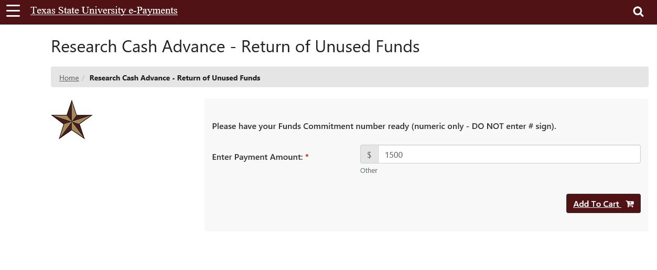
https://secure.touchnet.com/C24322_ustores/web/product_detail.jsp?PRODUCTID=2538&SINGLESTORE=true
Enter the amount you need to return:

Slide 3
Enter your name and commitment number:

Slide 4
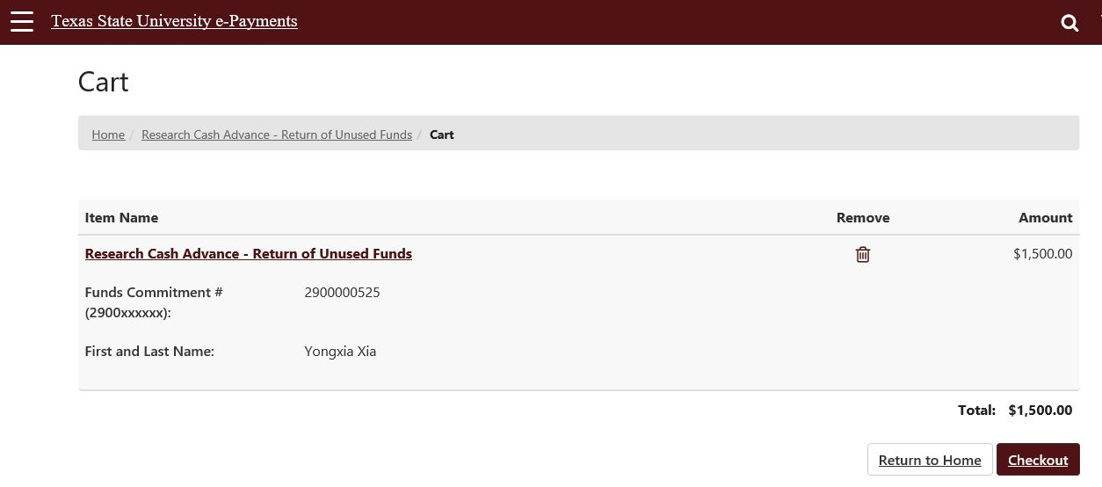
Check if you have entered the commitment number correctly:

Slide 5
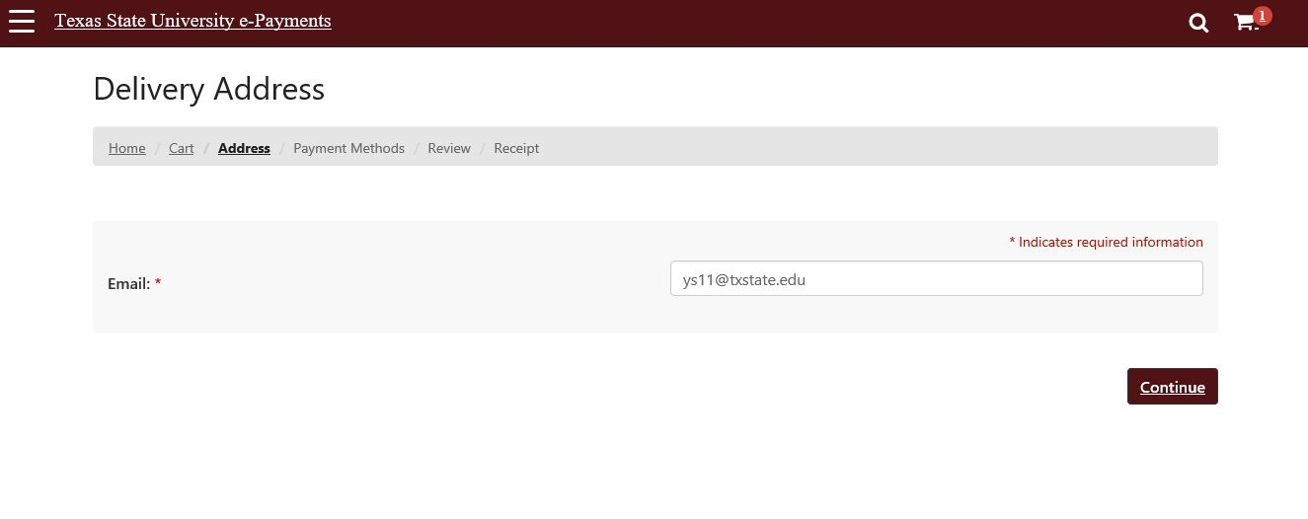
Enter your email address

Slide 6
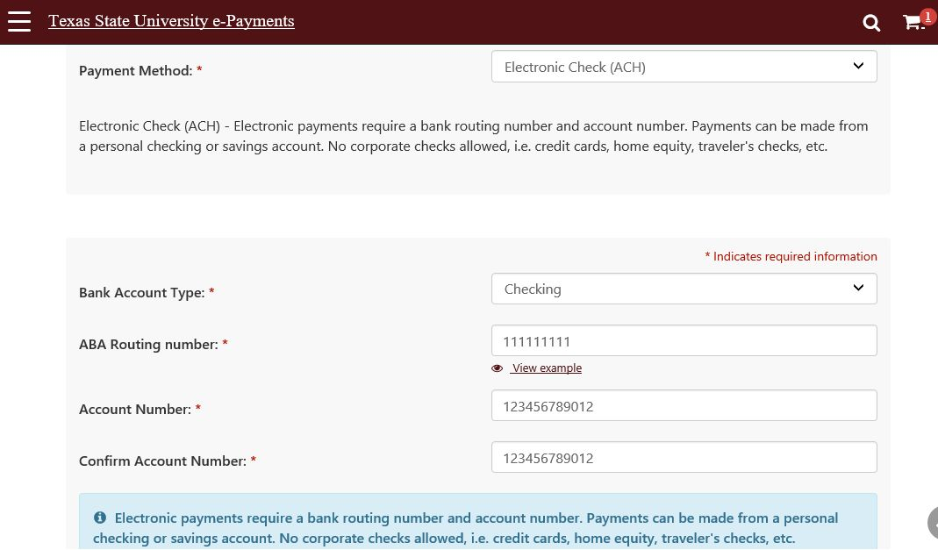
Enter your bank account information: you can find the routing and account numbers from your check book

Slide 7
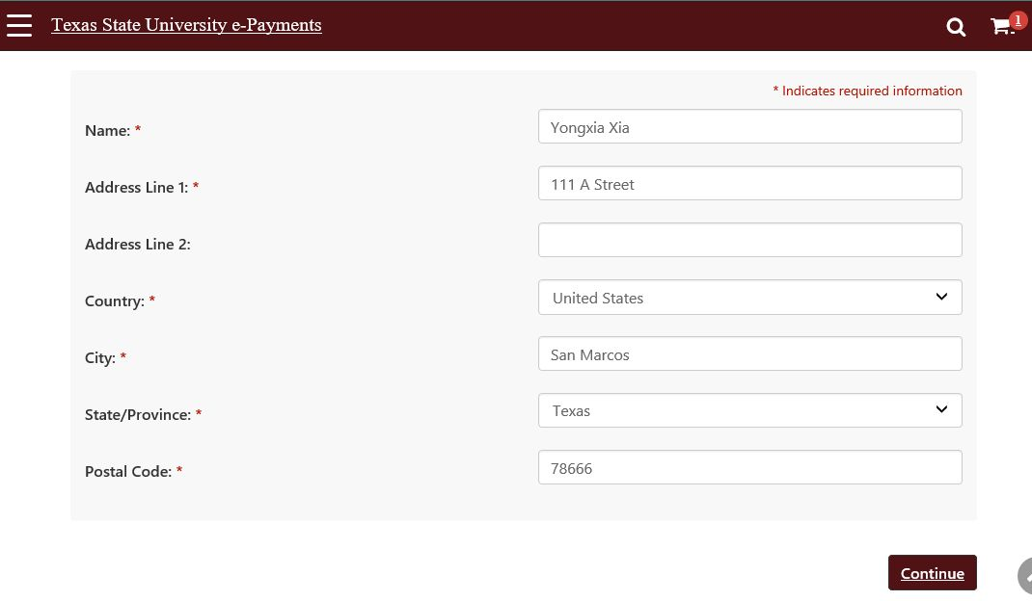
Enter your address

Slide 8
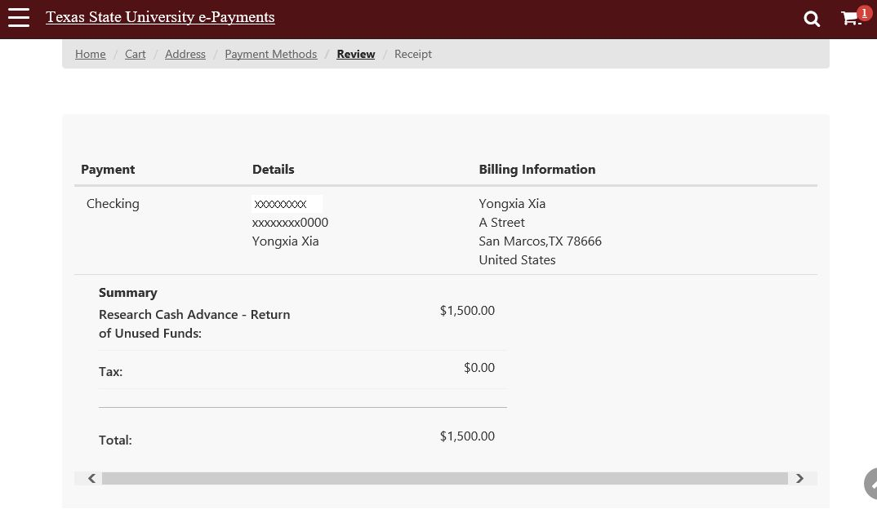
Review before submit

Slide 9
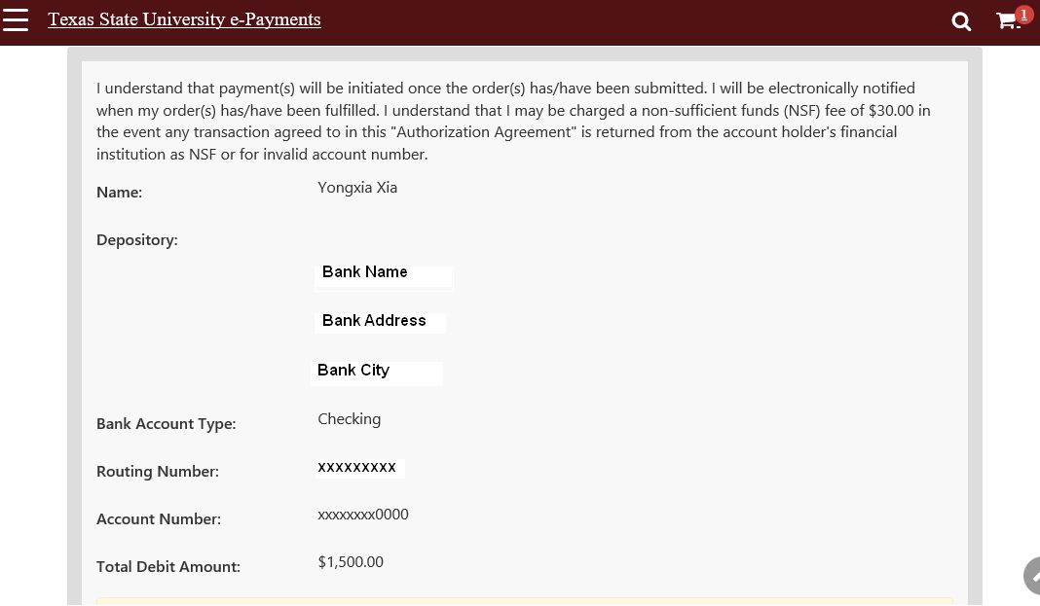
Review before submit

Slide 10
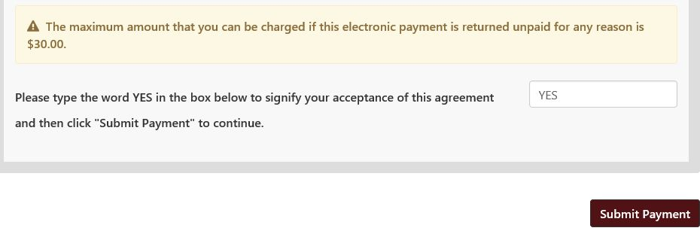
Type “YES” before submit

Slide 11
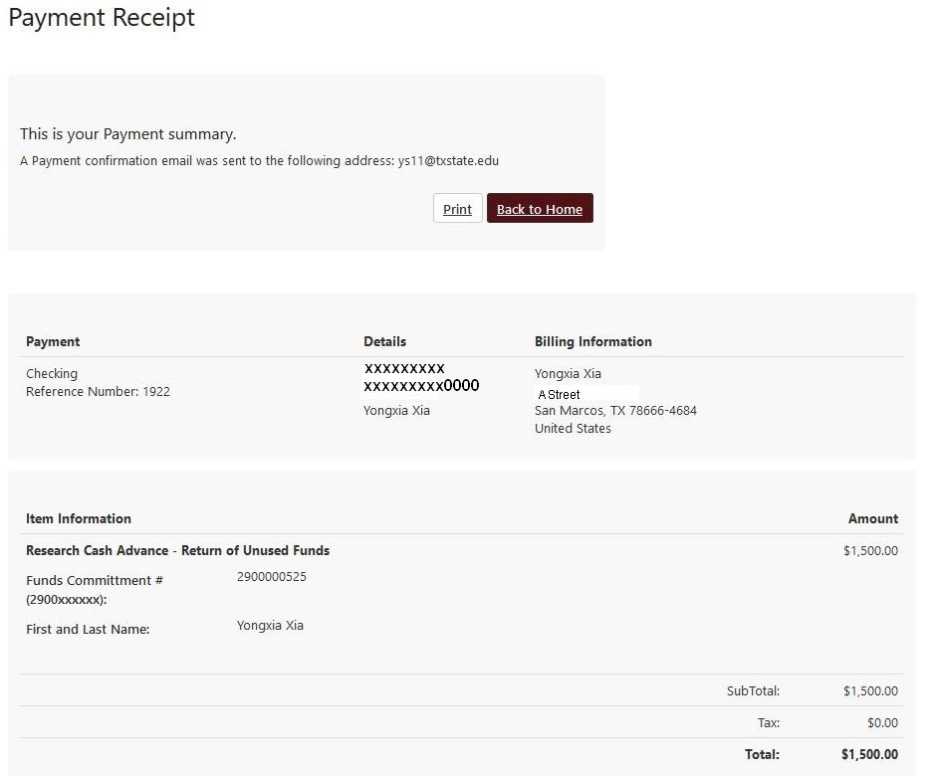

Slide 12
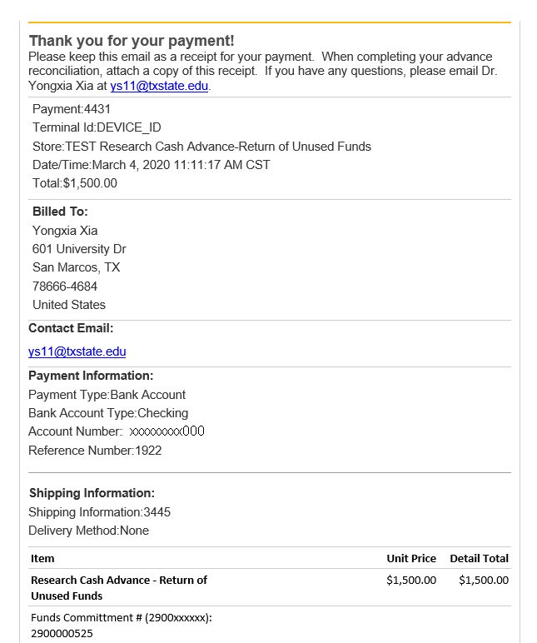
You will receive an email message as your receipt.
You need to upload this receipt with your reconciliation

